Slide 1
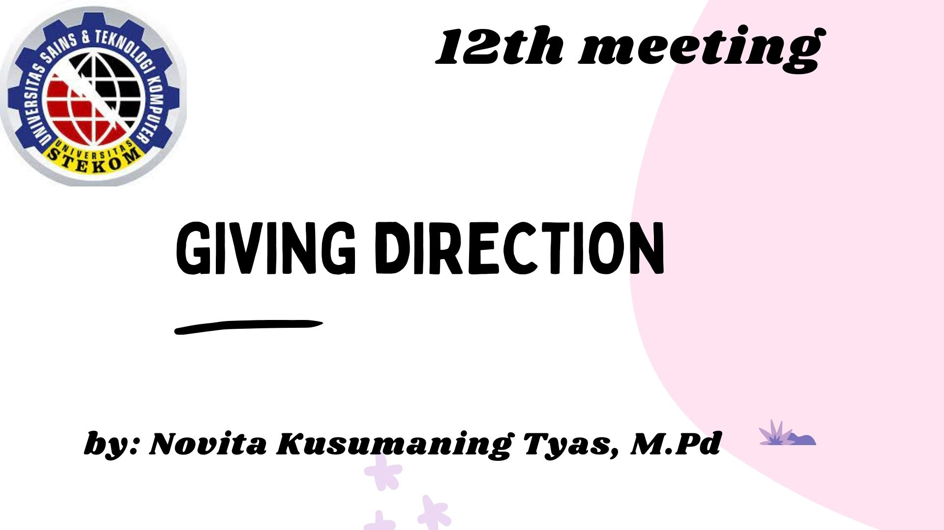

Slide 2
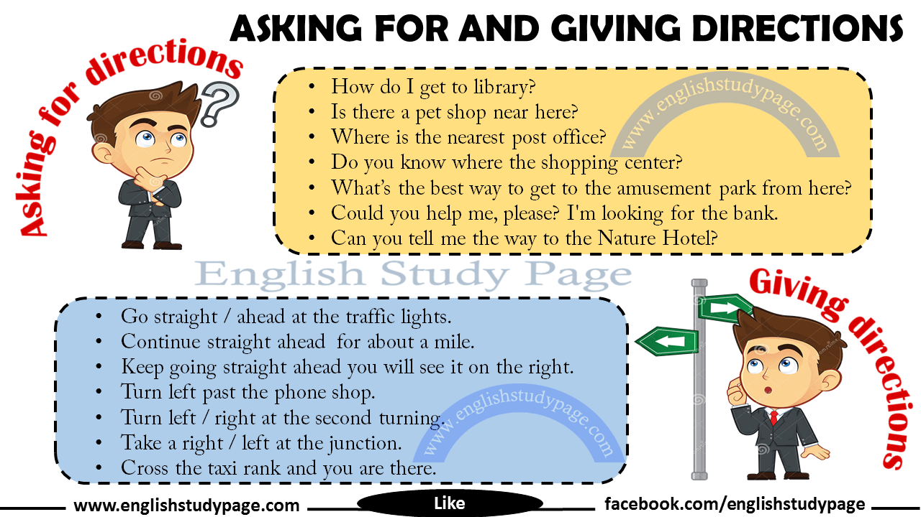

Slide 3
Before Asking For Directions:
Starting to conversation kindly is very good way. So, when we start talking, we can use the following forms:
Examples:
Excuse me / Excuse me sir or madam.
I am new here.
I’m lost.
I am sorry to interrupt you, but…
Excuse me, could you help me, please?
I am sorry.
Sorry, I am not from around here.
Excuse me madam, I seemed to be lost.
Hello / Hello sir or madam.

Slide 4
Asking directions:
Sometimes we or someone need to find a place. And we need to ask someone else for help. When we’re asking for directions to someone, we use some phrases. These are given below;
Examples:
Can you give me directions to the nearest hospital?
Are we on the right road for London?
How do you get to the bus stop?
Where is the carnival?
Where can I find the nearest car park?
How do I get to library?
Is there a pet shop near here?
Where is the nearest post office?
Do you know where the shopping center is?
Is there a sports shop around here?
Can you tell me how to get to train station from here?
How can I get to the pub?
What’s the best way to get to the amusement park from here?
What’s the quickest way to get to the airport from here?
What’s the easiest way to get to the nearest drugstore from here?
Could you tell me where the nearest grocery store is?

Slide 5
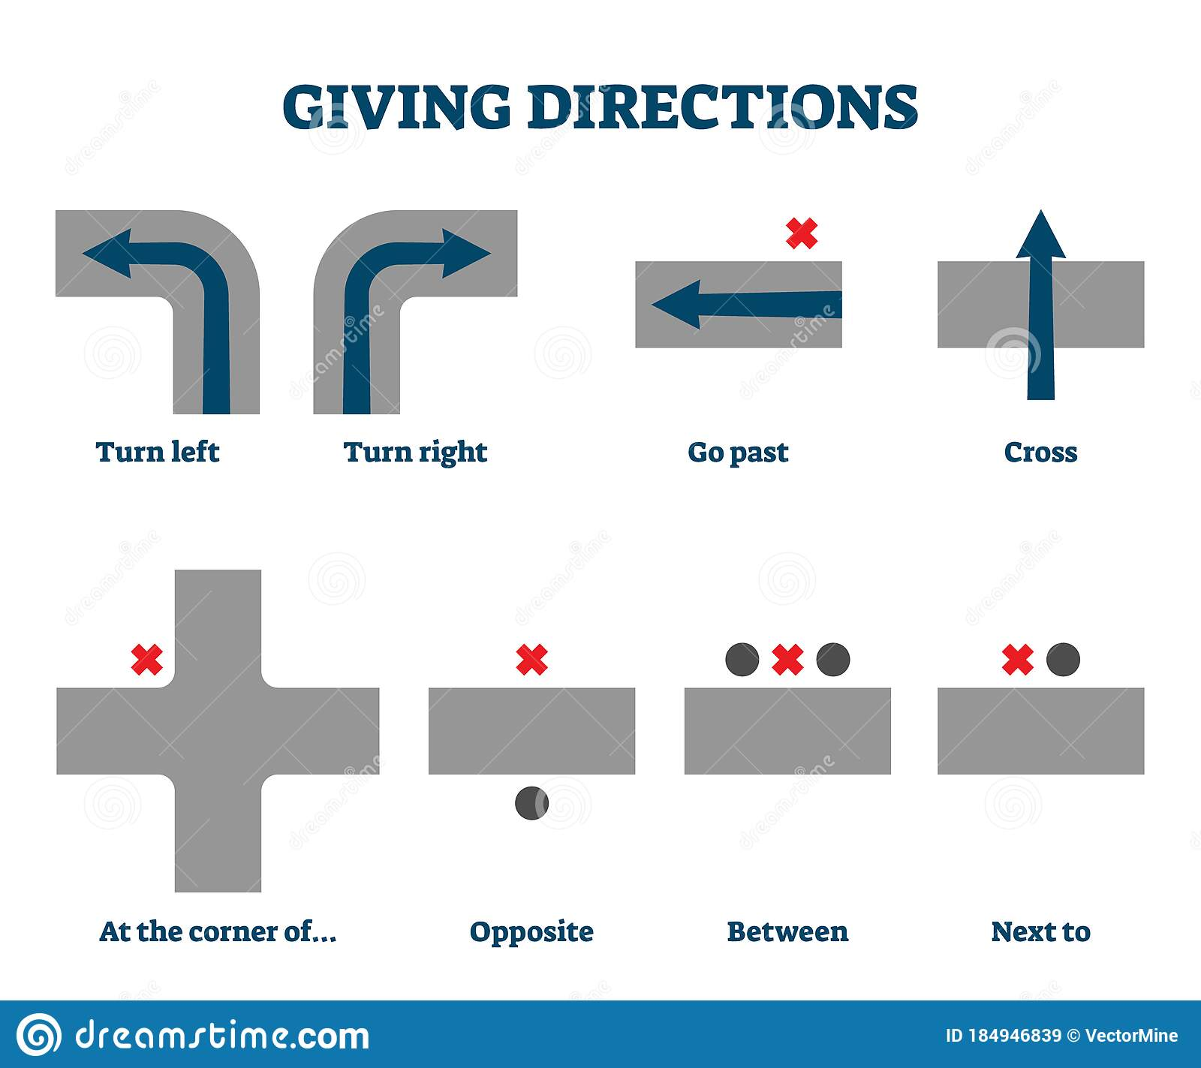
Answering the question:
1. If we don’t know the answer, we can say;
I am sorry.
I don’t know.
I am stranger here myself.

Slide 6
a. Giving Directions to Say ‘Go Straight’;
Go straight.
Go along the road.
Go down there.
Go down or walk down the street.
Go up or walk up the street.
Go straight along this road.
Go past the bus stop.
Go toward the church.
Go ahead.
Go straight ahead
Keep going for another station.
Keep going down this Street.
Keep going for another shop hundred metres.
Keep going straight ahead you will see it on the right.
Keep on the straight road.
Keep walking ahead.
Take this road.

Slide 7
b. Giving Directions to Say ‘Turn’;
Turn right.
Turn left.
Turn left past the bank. ( pass the bank and then turn left )
Turn back. ( go back)
Turn left after the bridge.
Turn right at the second turning ( turn left when you reach the turning )
Turn right from the first alley.
Turn left on to Daniel Street.
Turn left at the end of the corridor.
Turn right / left at the traffic lights / roundabout, etc.
Turn right on after you pass the market on the right also.
Turn left after you pass the bakery.
Turn left past the phone shop.
When you see a school on your right hand side, turn left in to European Street.
Turn left after you pass the bakery.
Go right / left at the end of the road.
Take the first right”.
Take the first / second / third street on the left / right.
Take the first left when you enter Steven Road.
You need to take a left / a right at the next traffic lights.
Take a right / left at the junction.
Take the second exit at the T- junction and then turn right at the traffic rights.
When you get to Paris Street, take your next right.
After you pass the restaurant on your left, take a right at the next crossroad.
If you take the road on the left, you’ll come to the post office.
Take a left when you come to the main street.
Round the corner from the post office.

Slide 8
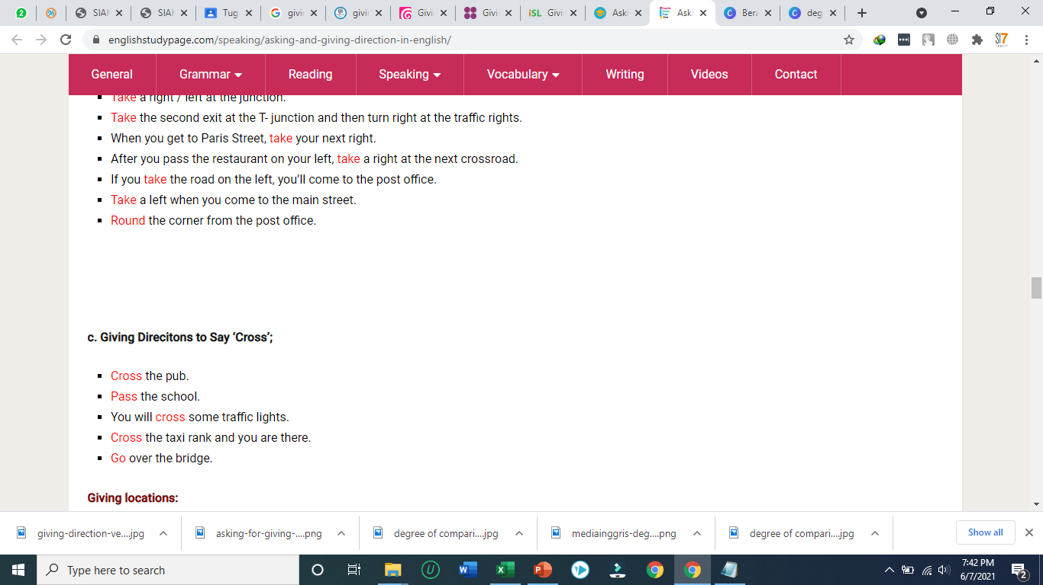
next to Mall.
behind the hospital.
in front of the bus station.
between the our office and the supermarket.
on the right in between the pet shop and the grocery store.
at the end of Paris Street.
on/at the corner of Daniel Road.
over there, near the police station.
just right / left around the corner.
(just) around the corner.
just around the corner on the left / right side.
left around the corner next to the market.
left around the corner from the subway.
further down the road on the left.
the biggest / smallest building on the left.
in the centre of the town.
the first turning on the right after the bank.
Giving locations:
It is …
on the left.
on left.
on the right.
on right side.
on the straight ahead.
on left after the gas station.
straight ahead on the right.
straight ahead of you.
straight ahead on the left next to the book shop.
opposite.
opposite the bank.
on opposite side of the Street.
across the road.
near my office.

Slide 9
Asking for and Giving Directions Conversations
Emily : Excuse me, I’m afraid I can’t find a petrol station. Do you know where one is?
Bill : There’s one near here.
Emily : How do I get there?
Bill : At the bus stop, take the first right and go straight on. It’s opposite the shopping mall.
Emily : Thank you so much!

